Slide 1
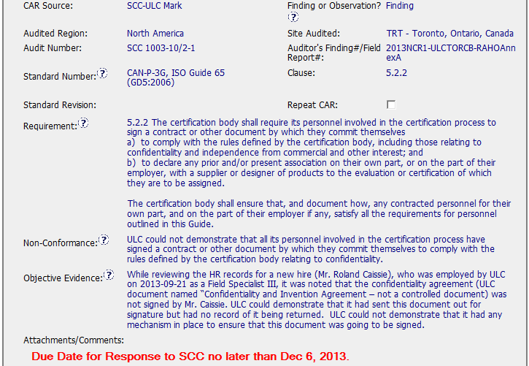
CAR 133912678 Review
Requirements match the nonconformance
Evidence matches the nonconformance
Due date to accreditor is specified

Slide 2
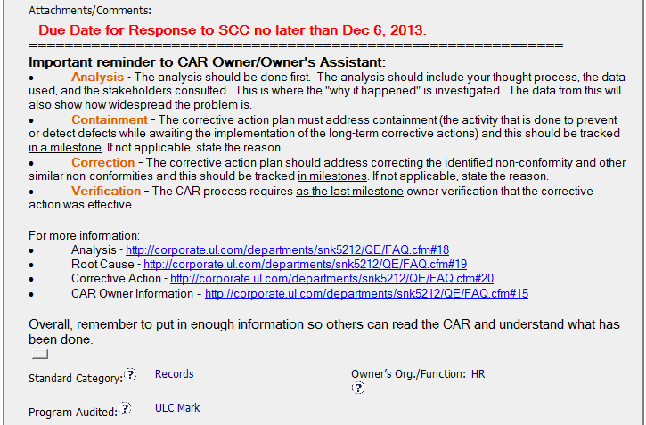
Good information provided to Owner. . .
. . . suggest adding guidance on the Scope of Nonconformance

Slide 3
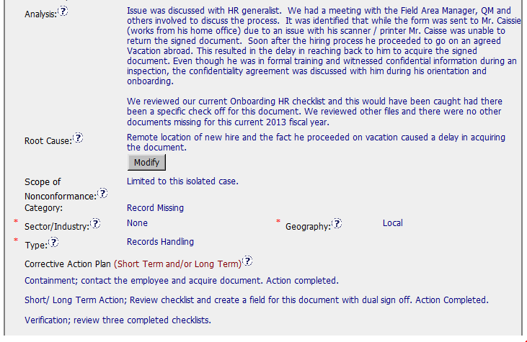
Titles of participants in Analysis, gives true root cause why defect was not detected.
Root Cause Statement gives only part of the story. True root cause why defect wasn’t detected is that the checklist didn’t have checkbox to ensure agreement was received.
Correct category. Scope addressed. Corrective actions address the true root cause.

Slide 4
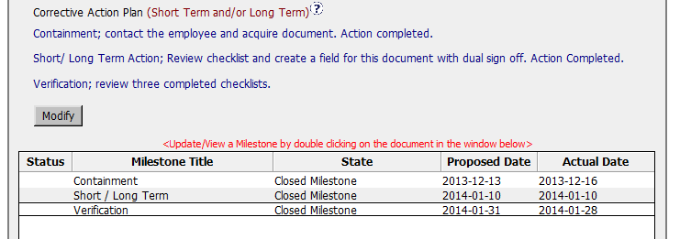
Milestones
Milestones match Corrective Action Plan

Slide 5
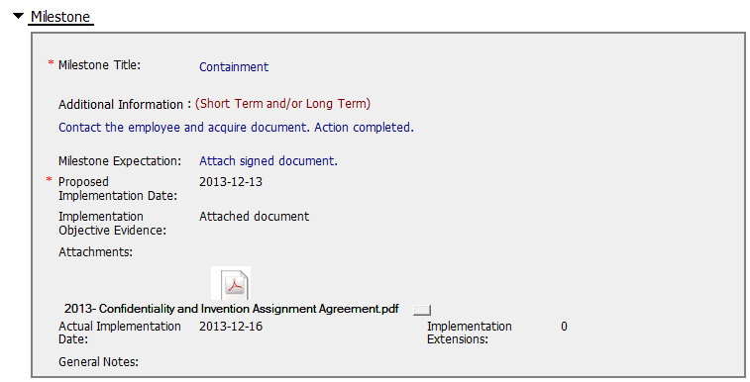
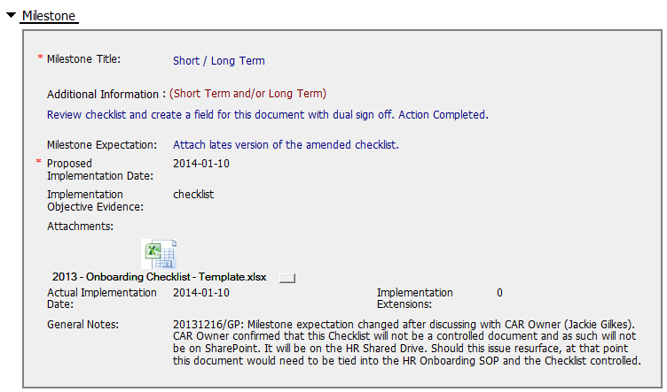
First Milestone OK.
Second Milestone shows updated checklist but no evidence of document control. This is acknowledged in the General Notes.

Slide 6
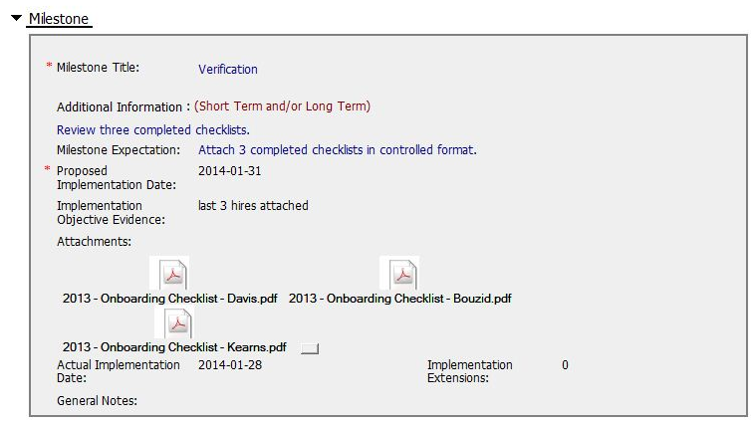
Third Milestone has appropriate evidence
These checklists contained confidential information that should have been obscured before placing into the CAR (this was corrected as part of this review).

Slide 7
CAR Timeline
Date | Elapsed Days | Task
11/8/2013 | -10 | Composed
11/18/2013 | 0 | Submitted
11/18/2013 | 0 | Assigned to Owner
11/28/2013 | 10 | Response Submitted
11/28/2013 | 10 | Response Approved FAST APPROVAL
12/6/2013 | 18 | Milestone Reminder
12/14/2013 | 26 | Implementation Overdue OVERDUE…
12/16/2013 | 28 | Implementation Submitted …THEN SUBMITTED
12/16/2013 | 28 | Implementation Approved FAST APPROVAL
1/3/2014 | 46 | Milestone Reminder
1/10/2014 | 53 | Implementation Submitted
1/13/2014 | 56 | Implementation Approved FAST APPROVAL
1/24/2014 | 67 | Milestone Reminder
1/28/2014 | 71 | Implementation Submitted
2/3/2014 | 77 | CAR Closed FAST APPROVAL
5/2/2014 | 165 | Confidential information removed.
CAR LIFE: 77 days from assignment to closure.

Slide 8
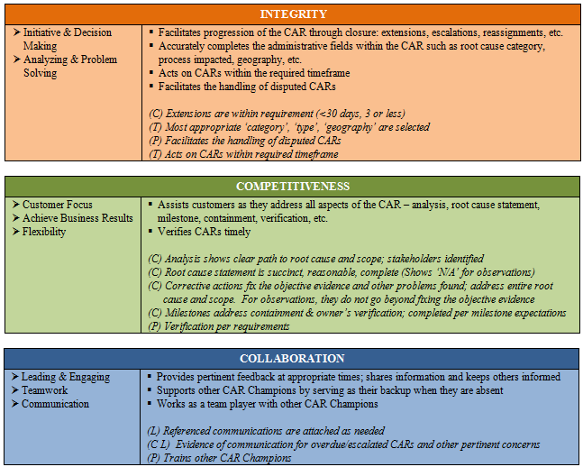

Demonstrated Critical Behaviors for Success

Slide 9
Corrective Action Review for Calibration Meeting (May, 2014)
Team B:
Jim Carlisle, John Carlin and Rebeca Navarrete

Slide 10
CAR 133912678 - SCC Audit Finding
SUMMARY:
Requirement, Non-Conformance and OE clearly stated
Sample size could have been included to give scope perspective
Attachments/Comments included important reminders for analysis, Containment, CA and Verification, with links to more information
Correct Type, Category and Geography assigned
CAR owner replied promptly with analysis and CA plan
No extensions required by the CAR owner
All parties involved not completely identified in Analysis
Review of process and other records conducted to determine scope (evidence not attached)
Root Cause could have also included checklist
Scope of NC appropriate (isolated occurrence)
One milestone was late, but others were on time
Good OE included in milestones
Checklist is not a controlled document

Slide 11

CAR 133912678 - SCC Audit Finding
Analysis:
It is preferred to identify who was involved during the analysis.
Included a review of the process and other files to determine scope.
Could have included list of records reviewed to determine isolated occurrence.

Slide 12
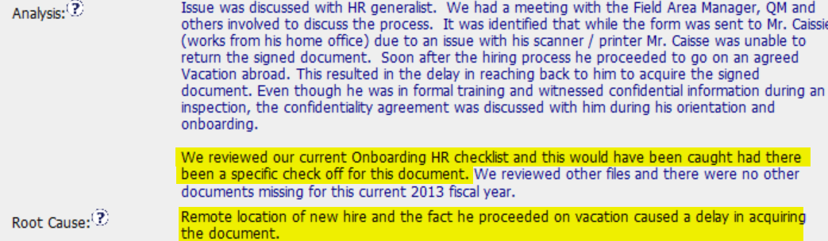
CAR 133912678 - SCC Audit Finding
Root Cause Statement: While the remote location and vacation contributed to the issue, the root cause could have also included the checklist.
Scope of Nonconformance: Based on the analysis, as well as only one record cited in the nonconformance, the scope of nonconformance as an isolated case seem appropriate.

Slide 13
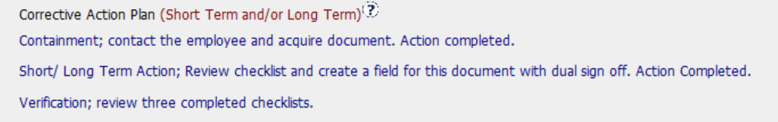
CAR 133912678 - SCC Audit Finding
Corrective Action plan: Included containment, short/Long Term CA and verification.

Slide 14
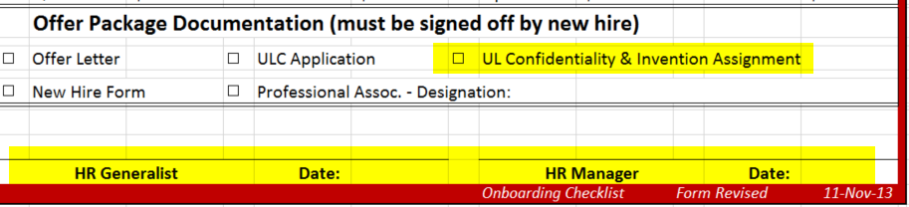
CAR 133912678 - SCC Audit Finding
Milestones:
Containment Milestone:
Overdue by 3 days
Included signed Confidentiality Agreement
Short / Long term
Completed on time
Included revised Onboarding Checklist
Note on MS indicates Checklist is not a controlled document, but maintained on the HR Shared Drive. Should issue resurface doc would need to be tied to HR Onboarding SOP.
Verification:
Completed on time
Included 3 completed checklists as evidence of effectiveness

Slide 15
CAR 133912678 - SCC Audit Finding
INTEGRITY: Initiative & Decision Making / Analyzing & Problem Solving
Facilitates progression of the CAR through closure: extensions, escalations, reassignments, etc. (+)
Accurately completes the administrative fields within the CAR such as root cause category, process impacted, geography, etc. (+)
Acts on CARs within the required timeframe (-)
Most appropriate ‘category’, ‘type’, ‘geography’ are selected (+)

Slide 16
CAR 133912678 - SCC Audit Finding
COMPETIVENESS: Customer Focus / Achieve Business Results / Flexibility
Assists customers as they address all aspects of the CAR – analysis, root cause statement, milestone, containment, verification, etc. (+)
Verifies CARs timely (+)
(C) Analysis shows clear path to root cause and scope; stakeholders identified (-)
(C) Root cause statement is succinct, reasonable, complete (-)
(C) Corrective actions fix the objective evidence and other problems found; address entire root cause and scope. (+)
(C) Milestones address containment & owner’s verification; completed per milestone expectations (+)
(P) Verification per requirements (+)
COLLABORATION: Leading & Engaging / Teamwork / Communication
Provides pertinent feedback at appropriate times; shares information and keeps others informed (+)

Slide 17
Finding CAR # 133912678 (Ronald Tse)

Slide 18
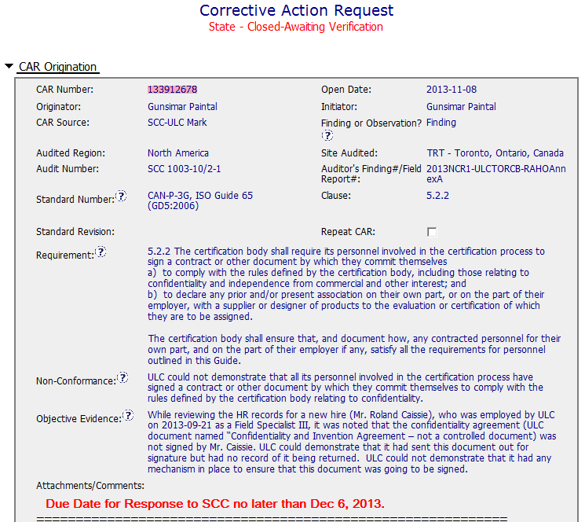
CAR No. 133912678

Slide 19
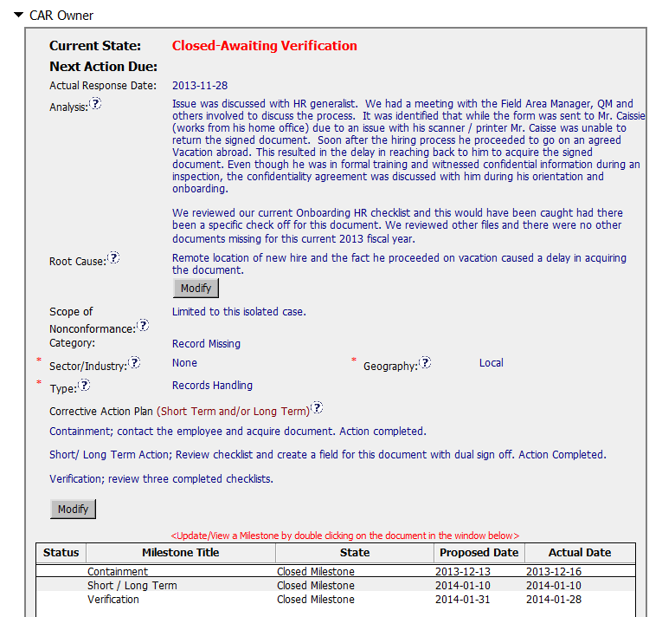
CAR No. 133912678
The “5 WHYs” approach hasn’t been utilized. At least its rationale hasn’t been well illustrated and documented in this field as record.
It sounds to be that “remote working location”, “broken scanner” and “personal vacation” are some reasons only resulting such nonconformance… They may not be root causes.
There is no statement indicating that what specific nonconformance is found after the root cause analysis, although the widespread of the discrepancy has been mentioned in the “Analyze” field.
While both “remote working location” and “personal vacation” are identified as root causes (not sure where does the “broken scanner” go as it is ever mentioned in the “Analyze” field), by applying the common logics, it doesn’t make very much sense that they are the root causes of the discrepancy resulting the unavailability of the required and signed employee confidentiality record.
[Collaboration] (C L) – To be improved by engaging with CAR Owner to get deeper analysis.
[Competitiveness] (C) – To be improved by engaging with CAR Owner to get a clear path of analysis.
[Integrity] (P) – To be improved of determination by declining the insufficient analysis results.
Notes:
00-QA-S0006 (#18.0) - Corrective Action Request Process

Slide 20
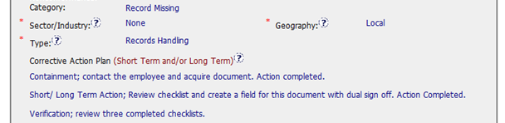
CAR No. 133912678
It is more appropriate to choose “All Sectors” instead of “None” in the Sector/Industry because the employee included in this assessment is a Field Rep.
Besides, not clearly illustrated in the field of “Analysis” to support it to be “Local” (isolated case?)
However, if it relates to the Corrective Actions, it is insufficient. First of all, it doesn’t seem that the so called root causes “remote working location” and “personal vacation” have ever been responded in here correspondingly. The logics have not been well elaborated.
Secondly, as mentioned in the part of “Analyze” and “Root Cause” above, the assessment are incomplete, e.g. would the discrepancy be due to no centralized system for monitoring and record retention, and/or insufficient process for requiring the new hire employee to sign all necessary documents prior to reporting to duty? It might has more specific corrective action items.
[Collaboration] (C L) – To be improved by engaging with CAR Owner to get succinct and reasonable root cause statement.
[Competitiveness] (C) – To be improved by engaging with CAR Owner to get succinct and reasonable root cause statement.
[Integrity] (P) – To be improved of determination by declining the incomplete root cause.
Notes:
00-QA-S0006 (#18.0) - Corrective Action Request Process

Slide 21
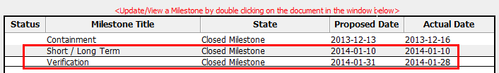
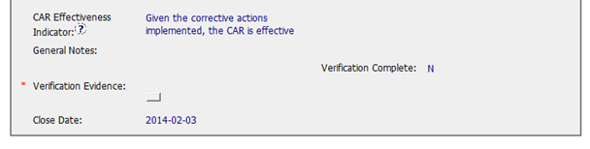
CAR No. 133912678
Owner’s verification is added at the last milestone but it shouldn’t be limited to the Checklist, those 3 confidentiality agreement records should also be required as milestone expectation for examination too. Besides, it leaves to little time frame to have sufficient verification on the new record.
Suggest to awaiting new records for examination, e.g. by a quarter or longer time, with considering new employment might not happen very frequently.
It might be too soon to be commented as effective in the field of “CAR Effectiveness Indicator”.
[Collaboration] (C L) – To be improved by working with CAR Owner to get the reasonable CA Plan that is able to fix the root cause.
[Competitiveness] (C) – To be improved by engaging with CAR Owner to fix the objective evidence and other problems found.
[Integrity] (P) – To be improved of determination by declining the insufficient CA Plan.
Notes:
00-QA-S0006 (#18.0) - Corrective Action Request Process

Slide 22
CAR# 133912678 (Overall Comment)
Analyze, Root Cause and Corrective Action Plan could be further improved by applying deeper 5 WHYs’ analysis, and hence determined with a detailed and effective corrective actions.
More milestones suggest to be added with clearer milestone expectation.

